Slide 1
OBJECT ORIENTED
PROGRAMMING
Spring 2024
Miss Ayesha Majid

Slide 2
LECTURE – 9 - 10

Slide 3
More on Java Constructors

Slide 4
Default Constructor
A default constructor in Java is a constructor without parameters, ie
public class defaultClass {
public defaultClass()
{}}
It is automatically generated by the compiler if no constructors are explicitly defined in the class.
In Java, we have a default constructor that doesn't take any arguments. We typically use it to initialize fields to their default values.
The default value for the variables of numeric types such as byte, int, short, and long is 0. The default value for float and double is 0.0. The default value for boolean is false. The default value for the reference variables is null.

Slide 5
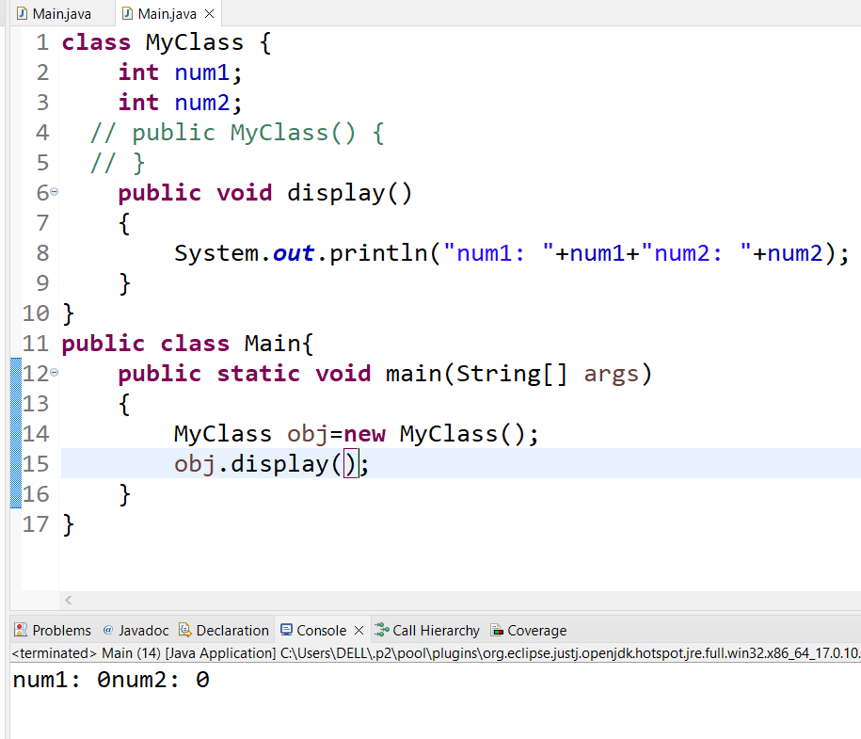
Sample Example 1:
Following is the output we get if we don’t initialize our instance variables ourselves in constructor. A default constructor is invoked in such case which initializes the value of variable to either null or zeros.

Slide 6
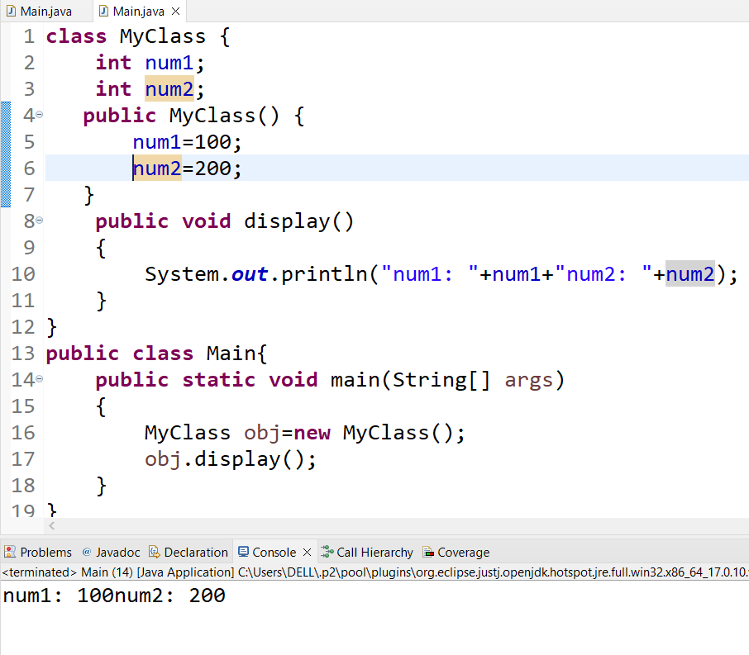
Sample Example 2:

Slide 7
Sample Example 3:
public class Main {
private int x;
private String y;
public Main() {
this.x = 5;
this.y = "Hello";
}
public int getX() {
return x;
}
public String getY() {
return y;
}
public static void main(String[] args) {
Main myClass = new Main();
System.out.println(myClass.getX());
System.out.println(myClass.getY());
}
}

Slide 8
Example Explained:
In the example above, we'll initialize the fields x and y to their default values (5 and “hello", respectively).
What if you don't write a default constructor for a class?
If you don't write a default constructor, the compiler will automatically generate one. However, this may not always be what you want. For example, if you have fields that need to be initialized to non-default values, you'll need to write your constructor.
It's generally a good idea to write your own default constructor, even if you don't initialize any fields. This makes your code more precise and easier to understand.
Let's differentiate between a default constructor and a no-argument constructor. The main difference between the two is that a default constructor will initialize fields to their default values. In contrast, a no-argument constructor will not initialize any fields.

Slide 9
Constructor Overloading
In Java, we can overload constructors like methods. The constructor overloading can be defined as the concept of having more than one constructor with different parameters so that every constructor can perform a different task.

Slide 10
Example
class Box {
double width, height, depth;
// constructor used when all dimensions
// specified
Box(double w, double h, double d)
{
width = w;
height = h;
depth = d;
}
// constructor used when no dimensions
// specified
Box() { width = height = depth = 0; }
// constructor used when cube is created
Box(double len) { width = height = depth = len; }
// compute and return volume
double volume() { return width * height * depth; }
}
// Driver code
public class Test {
public static void main(String args[])
{
// create boxes using the various
// constructors
Box mybox1 = new Box(10, 20, 15);
Box mybox2 = new Box();
Box mycube = new Box(7);
double vol;
// get volume of first box
vol = mybox1.volume();
System.out.println("Volume of mybox1 is " + vol);
// get volume of second box
vol = mybox2.volume();
System.out.println("Volume of mybox2 is " + vol);
// get volume of cube
vol = mycube.volume();
System.out.println("Volume of mycube is " + vol);
}
}

Slide 11
Parameterized constructor
A parameterized constructor is used when you have a class with multiple instance variables, and you want to initialize them with specific values at the time of object creation.

Slide 12
Example:
public class Car {
private String make;
private String model;
private int year;
// Parameterized constructor
public Car(String make, String model, int year) {
this.make = make;
this.model = model;
this.year = year;
System.out.println("This is my parameterized constructor and my car is "+ this.make + ", the model is "+ this.model + " and launched in year " + this.year);
}
public static void main(String[] args) {
// constructor is invoked while
// creating objects of Car
Car car1 = new Car("Toyota", "Corolla", 2022);
Car car2 = new Car("Honda", "Civic", 2023);
}
}

Slide 13
Explanation:
Line 7–13: The Car class has a parameterized constructor defined with three parameters: make, model, and year. When an object of the Car class is created using this constructor, the constructor is invoked with specific arguments and the instance variables make, model, and year are initialized with the provided values.
Lines 14–19: In the main method, two car objects are created, car1 and car2, each with different sets of values for make, model, and year.

Slide 14
Copy constructor
A copy constructor is a special constructor that creates a new object by copying the state of another object of the same class. It allows you to create a new object with the same values as an existing object, ensuring that the new object is an independent copy, not just a reference to the original one.
Let's create a Person class and implement a copy constructor.

Slide 15
Example
class Person {
private String name;
private int age;
// Parameterized constructor
public Person(String name, int age) {
this.name = name;
this.age = age;
}
// Copy constructor
public Person(Person other) {
this.name = other.name;
this.age = other.age;
}
// Getters and setters
public String getName() {
return name;
}
public void setName(String name) {
this.name = name;
}
public int getAge() {
return age;
}
public void setAge(int age) {
this.age = age;
}
public static void Main(String[] args) {
// Create an object using the parameterized constructor
Person person1 = new Person("John Doe", 30);
// Create another object using the copy constructor
Person person2 = new Person(person1);
// Modify person1 to demonstrate independence of objects
person1.setName("Jane Smith");
// Print the details of both persons
System.out.println("Person 1 - Name: " + person1.getName() + ", Age: " + person1.getAge());
System.out.println("Person 2 - Name: " + person2.getName() + ", Age: " + person2.getAge());
}
}

Slide 16
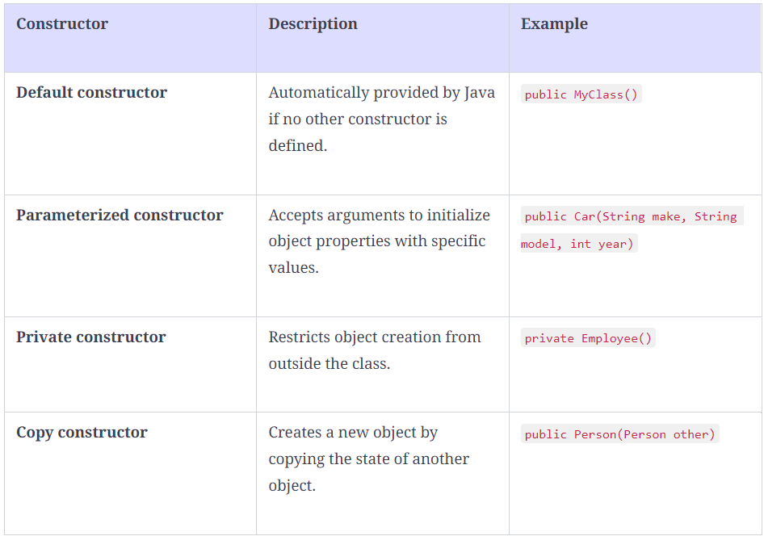
Types of constructors:

Slide 17
Introducing the concept of typecasting in Java
Typecasting is one of the most important concepts which basically deals with the conversion of one data type to another datatype implicitly or explicitly. In this article, the concept of typecasting for objects is discussed.
Just like the data types, the objects can also be typecasted. However, in objects, there are only two types of objects, i.e. parent object and child object. Therefore, typecasting of objects basically means that one type of object (i.e.) child or parent to another. There are two types of typecasting.

Slide 18
Upcasting
Upcasting is the typecasting of a child object to a parent object. Upcasting can be done implicitly. Upcasting gives us the flexibility to access the parent class members but it is not possible to access all the child class members using this feature. Instead of all the members, we can access some specified members of the child class. For instance, we can access the overridden methods.

Slide 19
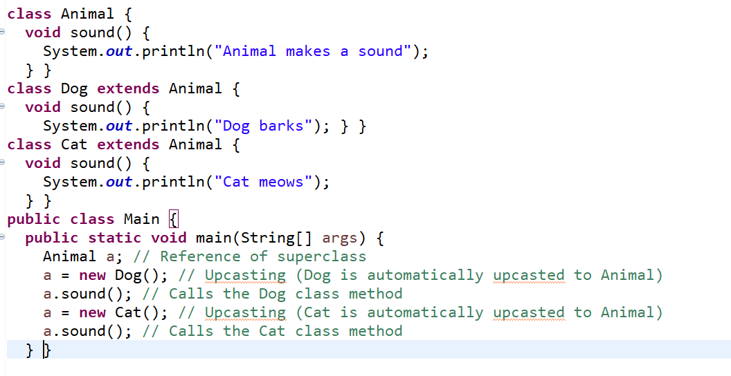
Example of Upcasting in Java

Slide 20
Downcasting
Similarly, downcasting means the typecasting of a parent object to a child object. Downcasting cannot be implicit.

Slide 21
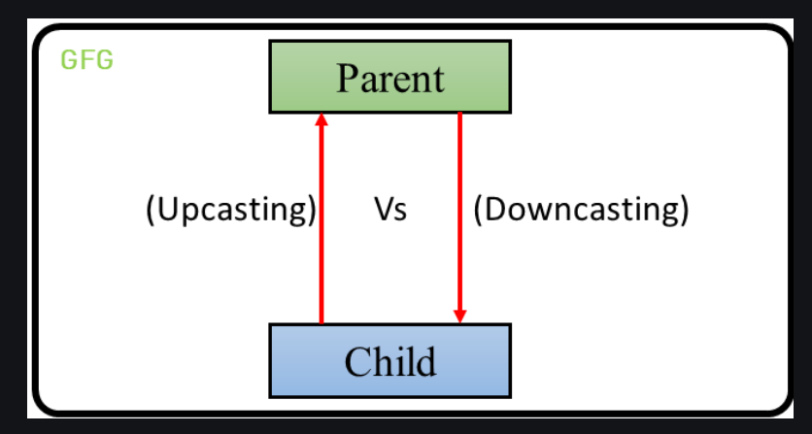
The following image illustrates the concept of upcasting and downcasting:

Slide 22
Example:
Let there be a parent class. There can be many children of a parent. Let’s take one of the children into consideration. The child inherits the properties of the parent. Therefore, there is an “is-a” relationship between the child and parent. Therefore, the child can be implicitly upcasted to the parent. However, a parent may or may not inherits the child’s properties. However, we can forcefully cast a parent to a child which is known as downcasting. After we define this type of casting explicitly, the compiler checks in the background if this type of casting is possible or not. If it’s not possible, the compiler throws a ClassCastException.
Let’s understand the following code to understand the difference:

Slide 23
Example
// Java program to demonstrate
// Upcasting Vs Downcasting
// Parent class
class Parent {
String name;
// A method which prints the signature of the parent class
void method()
{
System.out.println("Method from Parent");}}
// Child class
class Child extends Parent {
int id;
// Overriding the parent method
// to print the signature of the
// child class
@Override void method()
{
System.out.println("Method from Child");}}
// Demo class to see the difference
// between upcasting and downcasting
public class Main {
// Driver code
public static void main(String[] args)
{ // Upcasting
Parent p = new Child();
p.name = "GeeksforGeeks";
//Printing the parentclass name
System.out.println(p.name);
//parent class method is overridden method hence this will be executed
p.method();
// Trying to Downcasting Implicitly
// Child c = new Parent(); - > compile time error
// Downcasting Explicitly
Child c = (Child)p;
c.id = 1;
System.out.println(c.name);
System.out.println(c.id);
c.method();}}

Slide 24
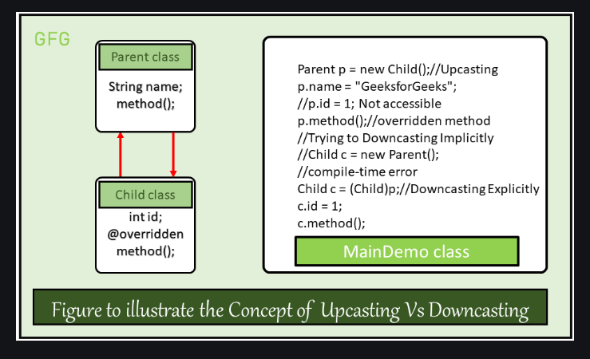
An illustrative figure of the above program:

Slide 25
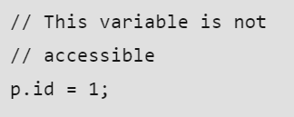
Syntax of Upcasting:
Parent p = new Child();
Upcasting will be done internally and due to upcasting the object is allowed to access only parent class members and child class specified members (overridden methods, etc.) but not all members.

Slide 26

Syntax of Downcasting:
Child c = (Child)p;
Downcasting has to be done externally and due to downcasting a child object can acquire the properties of the parent object.

Slide 27
Polymorphism

Slide 28
Polymorphism in Java
Polymorphism is one of the main aspects of Object-Oriented Programming(OOP). The word polymorphism can be broken down into Poly and morphs, as “Poly” means many and “Morphs” means forms. In simple words, we can say that ability of a message to be represented in many forms.

Slide 29
Introduction
Let us understand the definition of polymorphism by an example; a lady can have different characteristics simultaneously. She can be a mother, a daughter, or a wife, so the same lady possesses different behavior in different situations.
Another example of polymorphism can be seen in carbon, as carbon can exist in many forms, i.e., diamond, graphite, coal, etc. We can say that both woman and carbon show different characteristics at the same time according to the situation. This is called polymorphism.
The definition of polymorphism can be explained as performing a single task in different ways. A single interface having multiple implementations is also called polymorphism.

Slide 30
Types of polymorphism:
There are two main types of polymorphism i.e. runtime polymorphism and compile-time polymorphism. Runtime polymorphism is achieved through method overriding, and compile-time polymorphism is achieved through method overloading. Java doesn't support operator overloading but does internal operator overloading.

Slide 31
Method overloading
Consider a class where multiple methods have the same name. It will be difficult for the compiler to distinguish between every method.
To overcome this problem, we pass a different number of arguments to the method or different types of arguments to the method. In this way, we achieve method overloading.
In other words, a class can have multiple methods of the same name, and each method can be differentiated either by bypassing different types of parameters or bypassing a different number of parameters.

Slide 32
Example:
class CompileTime {
// perimeter method with a single argument
static int perimeter(int a) {
return 4 * a;
}
// perimeter method with two arguments (overloading)
static int perimeter(int l, int b) {
return 2 * (l + b);
}
}
class Polymorphism {
public static void main(String[] args) {
// calling perimeter method by passing a single argument
System.out.println("Side of square : 4\nPerimeter of square will be : " + Compiletime.perimeter(4) + "\n");
// calling perimeter method by passing two arguments
System.out.println("Sides of rectangle are : 10, 13\nPerimeter of rectangle will be : " + Compiletime.perimeter(10, 13));
}
}

Slide 33
Method overriding
If a child class has a method as its parent class, it is called method overriding.
If the derived class has a specific implementation of the method that has been declared in its parent class is known as method overriding.
Rules for overriding a method in Java
There must be inheritance between classes.
The method between the classes must be the same(name of the class, number, and type of arguments must be the same).

Slide 34
Example:
//parent class Animal
class Animal{
// creating place method
void place(){
System.out.println("Animals live on earth.");
}
}
// Dog class extends Animal class
class Dog extends Animal{
// overriding place method
void place(){
System.out.println("Dog lives in kennel.");
}
}
// Horse class extends Animal class
class Horse extends Animal{
// overriding place method
void place(){
System.out.println("Horse lives in stable.");
}
}
// Rabbit class extends Animal class
class Rabbit extends Animal{
// overriding place method
void place(){
System.out.println("Rabbit lives in burrow.");
}
}
class Polymorphism{
public static void main(String[] args) {
// creating object of Animal class
Animal A = new Animal();
A.place();
A = new Dog();
A.place();
A = new Horse();
A.place();
A = new Rabbit();
A.place();
}
}

Slide 35
Example 2:
// parent class Shape
class Shape{
// creating area method
void area(){
System.out.println("Formula for areas.");
}
}
// Square class extends Shape class
class Square extends Shape{
// overriding area method
void area(){
System.out.println("Area of square : a * a");
}
}
// Rectangle class extends Shape class
class Rectangle extends Shape{
// overriding area method
void area(){
System.out.println("Area of rectangle : 2 * (a + b)");
}
}
// Circle class extends Shape class
class Circle extends Shape{
// overriding area method
void area(){
System.out.println("Area of circle : pi * r * r");
}
}
class Polymorphism{
public static void main(String[] args) {
// creating new object of Shape class
Shape S = new Shape();
S.area();
S = new Square();
S.area();
S = new Rectangle();
S.area();
S = new Circle();
S.area();
}
}

Slide 36
Polymorphism in Java Example
// Parent class to illustrate run-time polymorphism
class Parent {
// creating print method
void print() {
System.out.println("Hi I am parent");
}
}
// Child class extends Parent class
class Child extends Parent {
// overriding print method
void print() {
System.out.println("Hi I am children");
}
}
// Overload class to illustrate compile-time polymorphism
class Overload {
// Creating a statement method
void statement(String name) {
System.out.println("Hi myself " + name);
}
// overloading statement method
void statement(String fname, String lname) {
System.out.println("Hi myself " + fname + " " + lname);
}
}
public class Main {
public static void main(String[] args) {
// creating instance of parent
Parent obj1;
obj1 = new Parent();
obj1.print();
obj1 = new Child();
obj1.print();
// creating instance of overload
Overload obj2 = new Overload();
obj2.statement("Soham.");
obj2.statement("Soham", "Medewar.");
}
}

Slide 37
Example of polymorphism in real-life
// parent class Livingthings
class Livingthings {
// creating live method
public void live() {
System.out.print("live on ");
}
}
// Animals class extends Livingthings
class Animals extends Livingthings {
// overriding live method
public void live() {
System.out.println("water, air, and land.");
}
}
// Humanbeing class extends Livingthings
class Humanbeing extends Livingthings {
// overriding live method
public void live() {
System.out.println("land.");
}
}
// Plants class extends Livingthings
class Plants extends Livingthings {
// overriding live method
public void live() {
System.out.println("water and land.");
}
}
class Polymorphism {
public static void main(String[] args) {
// creating new object of Livingthings class
Livingthings LT = new Livingthings();
Livingthings LT1;
LT1 = new Animals();
System.out.print("Animals ");
LT.live();
LT1.live();
LT1 = new Humanbeing();
System.out.print("Human beings ");
LT.live();
LT1.live();
LT1 = new Plants();
System.out.print("Plants ");
LT.live();
LT1.live();
}
}

Slide 38
Abstraction

Slide 39
Implementing an Abstract Method
As we all know from our childhood, animals have distinctive ways of speaking. A cow goes “moo”; a pig goes “oink”; and so on. Let’s design a hierarchy of animals that simulates this characteristic by printing the characteristic sounds that these animals make.
We want to design our classes so that any given animal will return something like “I am a cow and I go moo,” when we invoke the toString() method. Moreover, we want to design this collection of classes so that it is extensible—that is, so that we can continue to add new animals to our menagerie without having to change any of the code in the other classes.

Slide 40
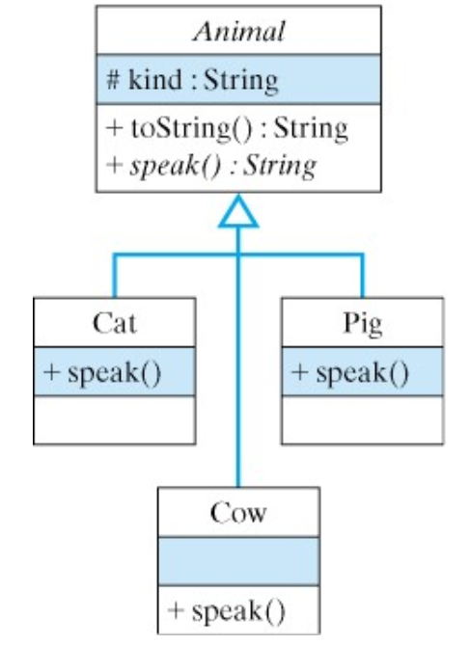
Abstract Method (Continue)
Figure provides a summary of the design. The Animal class is an abstract class. That’s why its name is italicized in the UML diagram. The reason that this class is abstract is because its speak() method is an abstract method, which is a method definition that does not contain an implementation. That is, the method definition contains just the method’s signature, not its body. Any class that contains an abstract method, must itself be declared abstract.

Slide 41
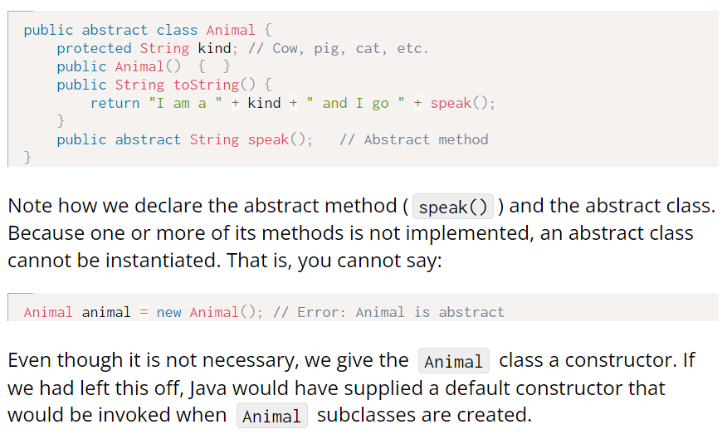
Here is the definition of the Animal class:

Slide 42
Rules on using abstract methods and classes:
Any class containing an abstract method must be declared an abstract class.
An abstract class cannot be instantiated. It must be subclassed.
A subclass of an abstract class may be instantiated only if it implements all of the superclass’s abstract methods. A subclass that implements only some of the abstract methods must itself be declared abstract.
A class may be declared abstract even it contains no abstract methods. It could, for example, contain instance variables that are common to all its subclasses.

Slide 43
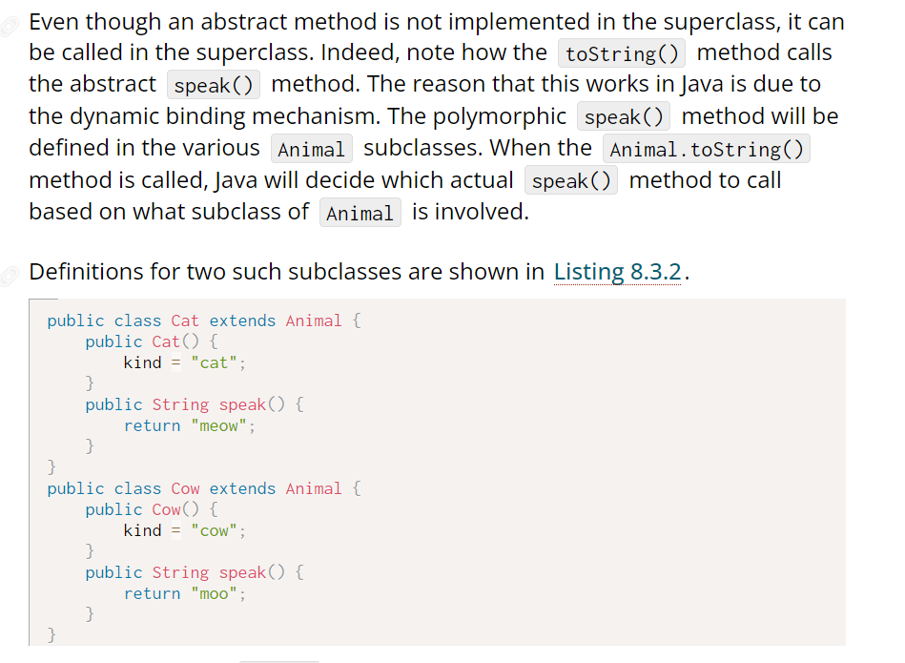
Abstract Method: Continue…

Slide 44
Abstract Method: Continue..
In each case the subclass extends the Animal class and provides its own constructor and its own implementation of the speak() method. Note that in their respective constructors, we can refer to the kind instance variable, which is inherited from the Animal class. By declaring kind as a protected variable, it is inherited by all Animal subclasses but hidden from all other classes. On the other hand, if kind had been declared public, it would be inherited by subclassesb ut it would also be accessible to every other class, a violation of the information hiding principle

Slide 45
Java Interface

Slide 46
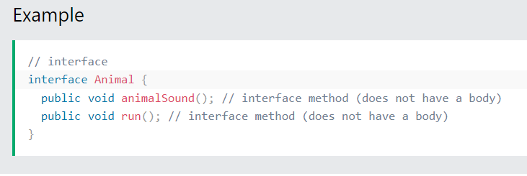
Interfaces
Another way to achieve abstraction in Java, is with interfaces.
An interface is a completely "abstract class" that is used to group related methods with empty bodies:

Slide 47
Accessing Interface Methods
To access the interface methods, the interface must be "implemented" (kinda like inherited) by another class with the implements keyword (instead of extends). The body of the interface method is provided by the "implement" class:

Slide 48
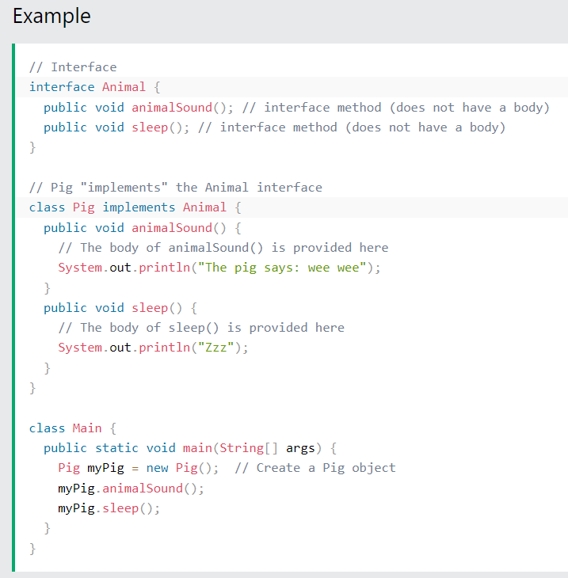
Example

Slide 49
Notes on Interfaces:
Like abstract classes, interfaces cannot be used to create objects (in the example above, it is not possible to create an "Animal" object in the MyMainClass)
Interface methods do not have a body - the body is provided by the "implement" class
On implementation of an interface, you must override all of its methods
Interface methods are by default abstract and public
Interface attributes are by default public, static and final
An interface cannot contain a constructor (as it cannot be used to create objects)

Slide 50
Why And When To Use Interfaces?
1) To achieve security - hide certain details and only show the important details of an object (interface).
2) Java does not support "multiple inheritance" (a class can only inherit from one superclass). However, it can be achieved with interfaces, because the class can implement multiple interfaces. Note: To implement multiple interfaces, separate them with a comma (see example below).

Slide 51
Java Encapsulation

Slide 52
Encapsulation
The meaning of Encapsulation, is to make sure that "sensitive" data is hidden from users. To achieve this, you must:
declare class variables/attributes as private
provide public get and set methods to access and update the value of a private variable

Slide 53
Get and Set
You learned from the previous chapter that private variables can only be accessed within the same class (an outside class has no access to it). However, it is possible to access them if we provide public get and set methods.
The get method returns the variable value, and the set method sets the value.
Syntax for both is that they start with either get or set, followed by the name of the variable, with the first letter in upper case:

Slide 54
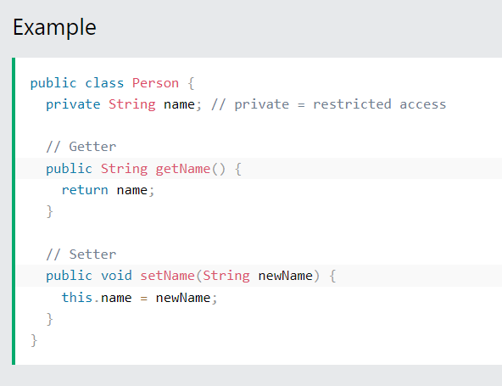
Example:

Slide 55
Example explained
The get method returns the value of the variable name.
The set method takes a parameter (newName) and assigns it to the name variable. The this keyword is used to refer to the current object.
However, as the name variable is declared as private, we cannot access it from outside this class:

Slide 56
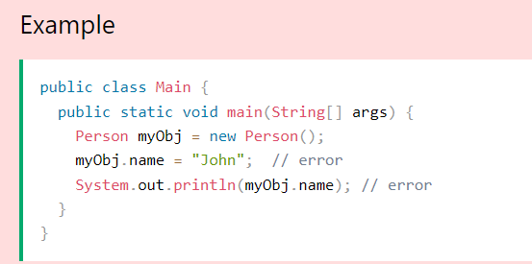
Example:

Slide 57
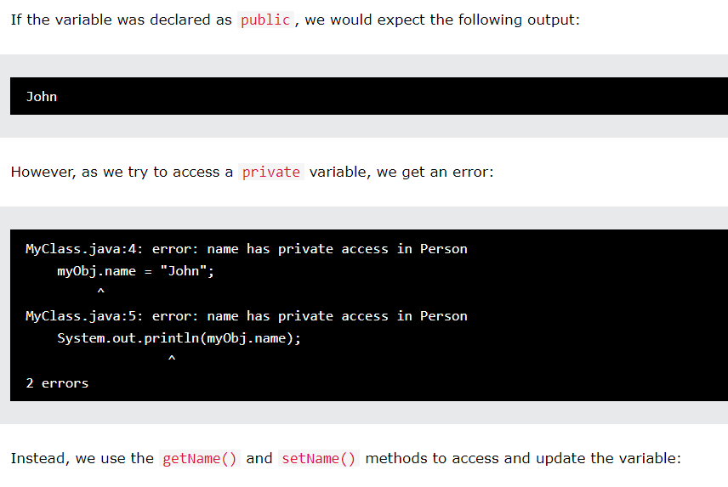
More on previous Example:

Slide 58
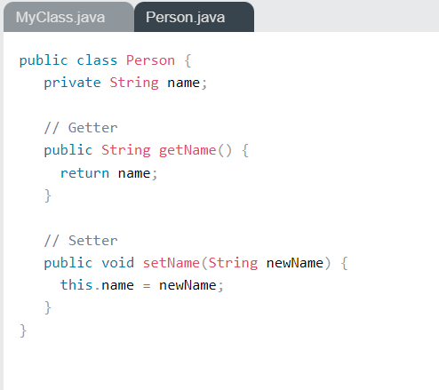
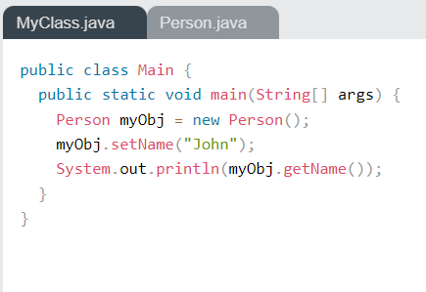
Example:

Slide 59
Why Encapsulation?
Better control of class attributes and methods
Class attributes can be made read-only (if you only use the get method), or write-only (if you only use the set method)
Flexible: the programmer can change one part of the code without affecting other parts
Increased security of data

Slide 60
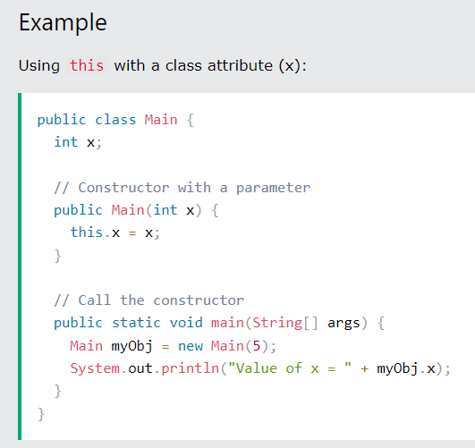
Java this Keyword

Slide 61
Definition and Usage
The this keyword refers to the current object in a method or constructor.
The most common use of the this keyword is to eliminate the confusion between class attributes and parameters with the same name (because a class attribute is shadowed by a method or constructor parameter). If you omit the keyword in the example above, the output would be "0" instead of "5".
this can also be used to:
Invoke current class constructor
Invoke current class method
Return the current class object
Pass an argument in the method call
Pass an argument in the constructor call

Slide 62
Resources:
https://www.w3schools.com
https://www.javatpoint.com/object-and-class-in-java
https://runestone.academy/ns/books/published/javajavajava/abstract-classes-interfacesand-polymorphism.html

